Slide 1
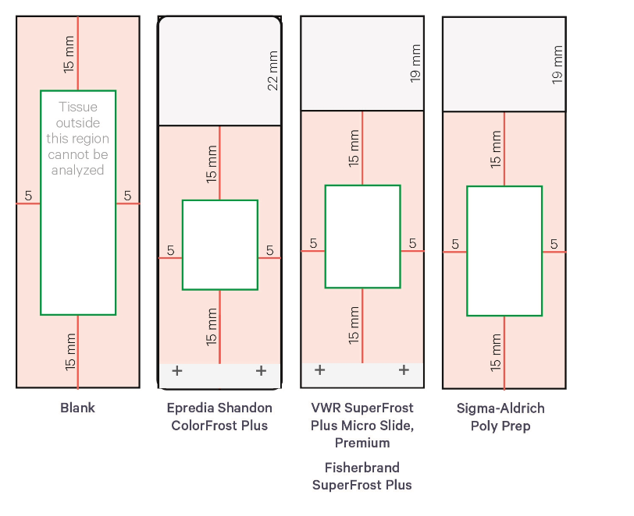
Print at 97% scale
8.5” x 11” paper

Slide 2
Editable version
Print at 97% scale
8.5” x 11” paper
15 mm
22 mm
19 mm
19 mm
15 mm
15 mm
15 mm
5
5
5
5
5
5
5
5
15 mm
15 mm
15 mm
15 mm
+
+
+
+

